Slide 1
Leaf Disease Detection Using Image processing
Group Members:
Chavan Rohan – 04
Kshitij Shukla – 84
Saniket Patil – 85
Project Guide – Mr. Vivian Lobo

Slide 2
Problem Statement
Real time image detection was not possible.
Use of low-pixel image leads to wrong prediction.
Disease recognition was only for a particular plant.

Slide 3
OBJECTIVE
To develop a prototype system for detecting the plant disease.
To enhance the quality of the image and to classify the plant disease.
To be further improved in the future to detect the plant related issues in the field of agricultural analysis.
To determine the percent of diseases in the plant.

Slide 4
Scope of the Project
Our System aims to be used mostly in the agricultural field and the users of this system are farmers.
Our System can run smoothly on any smartphone having android version lollipop (5.0) or the upgraded one. Also it can run efficiently on windows 8 and above.
It can provide the help for a person having less knowledge about the disease.

Slide 5
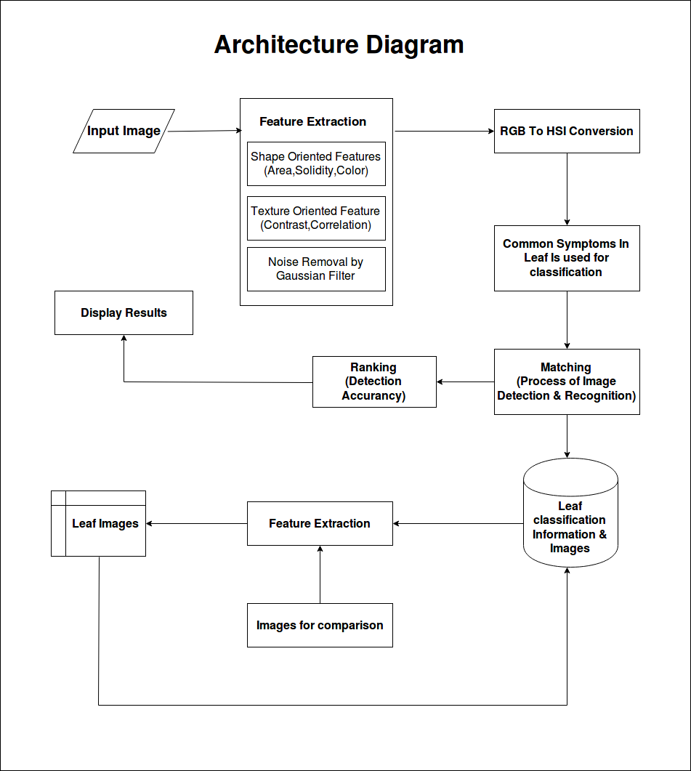
Architecture Diagram

Slide 6
Programming Language Used
Python
Java

Slide 7
Tools Used
IDE & FRAMEWORKS :-
Android Studio (3.0)
PyCharm (2018.1 EAP)
OpenCV (3.4.3)
Back End :
MySQL (8.0.12 Enterprise)

Slide 8
Thank You

